Slide 1
The 8th Open Virtual Expert Café
November 9, 2023, 1:00 pm CET
Ursula Holtgrewe, Leonie Dworsky
This project has received funding from the European Union’s Horizon 2020 research and innovation programme under grant agreement No 101004776
Notes:
We expect 17 participants today; so while some might be still coming in,
I suggest we start and trust they will find their way around.
Right, so, welcome everyone,
we have a few new participants today, so before we start with the presentations I suggest to have a very quick round of introductions, just in order to get a sense of who is here, who is listening
I will call on you in the sequence you appear on my screen and you can just – very very briefly – state what institution you are from or what sort of project you are working on, just to get a sense of the public‘s background.
Feel free to turn on the camera while introducing yourself, if you wish so.
So my name is Nela Šalamon, I am working at the Centre for Social Innovation in Vienna
right next to me on the screen is my colleague, Ursula Holtgrewe, so Ursula, you‘re next […]
[I then proceed to call who‘s next]

Slide 2
1
Rules of the game
Notes:
Quick reminder of what this format is and how it works:

Slide 3
The format
A low-threshold virtual forum for exchange on globalization, digitization, demographic change, work and employment
news, ideas, results, collaborations
Everybody’s welcome to contribute or listen and comment!
Contributors have a 5 minute time slot (may be 3 minutes or sometimes even 10) and 1 ppt slide (headline, keywords, links, contact data!) to present projects, ideas, results, partner searches …
A 90-minute virtual meeting
(the team: Ursula Holtgrewe, Leonie Dworsky)
Notes:
The format is really open exchange on globalization, digitization, demographic change, work and employment and related issues,
We can talk about news, ideas, results, possible collaborations if it makes sense
Whoever registers is welcome
You can decide whether to contribute, or just listen in - we’re quite open

Slide 4
2
Your hosts: the UNTANGLED project

Slide 5
The project
Pro-ductivity
Trade patterns
In-equality
Horizon Europe, Call TRANSFORMATIONS-18-2020
2/2021 – 1/2024
Economic and social science approaches
Scenarios
Policy briefs
Ongoing stakeholder engagement
Technological change
Demographic change
Globalisation
Employ-ment & work
skills
Newsletter
To get more targeted information: Register for the stakeholder community
Notes:
The project is doing research revolving – somewhat broadly speaking - around how demography, technology & globalisation affect labour markets,
And it is recommending policy responses.
On 20 Oct. Luxembourg Institute of Socio-Economic Research (LISER), a partner in the project, held a workshop in Luxembourg about the tensions on European labour markets caused by globalisation, digitalisation and demographic change.
Just last week the Untangled conference was held in Brussels, and also a policy workshop

Slide 6
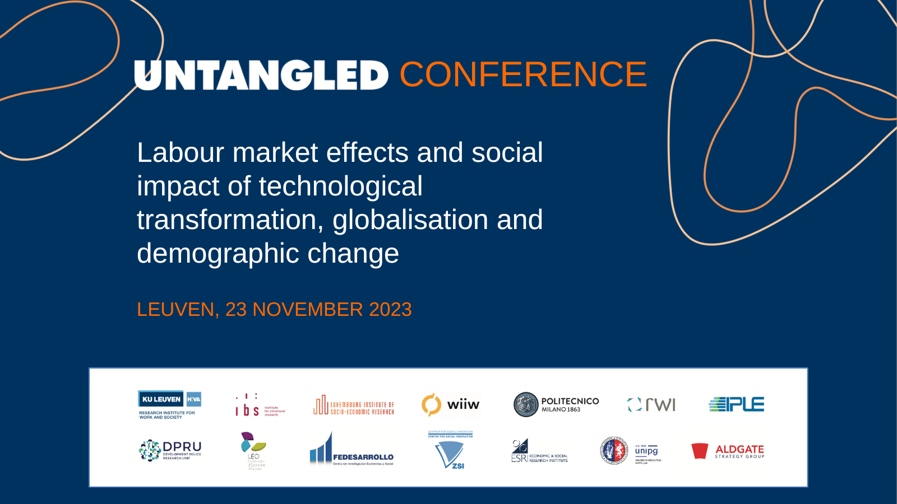
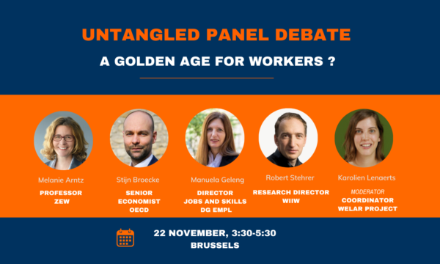
Next UNTANGLED events
https://projectuntangled.eu/untangled-events/ to register

Slide 7
3
Contributions

Slide 8
Overview
1. Ludivine Martin & Laetitia Hauret (LISER): “Labour shortages in trades not requiring a university degree: an exploratory study on the role played by working conditions”
2. Karina Doorley (ESRI): “Automation and Income Inequality in Europe”
3. İlayda Emine Nilüfer (Istanbul University): “To a sustainable world: Covid-19 and the dialectics of inequality”
4. Wojciech Szymczak & Piotr Lewandowski (IBS): UNTANGLED Policy Brief: “Fostering lifelong learning as the market for skills evolves”
5. Philip Schörpf & Myriam Gaitsch (FORBA): “From interested self-endangerment to toxic willingness to perform”
This project has received funding from the European Union’s Horizon 2020 research and innovation programme under grant agreement No 101004776
Notes:
We expect 17 participants today; so while some might be still coming in,
I suggest we start and trust they will find their way around.
Right, so, welcome everyone,
we have a few new participants today, so before we start with the presentations I suggest to have a very quick round of introductions, just in order to get a sense of who is here, who is listening
I will call on you in the sequence you appear on my screen and you can just – very very briefly – state what institution you are from or what sort of project you are working on, just to get a sense of the public‘s background.
Feel free to turn on the camera while introducing yourself, if you wish so.
So my name is Nela Šalamon, I am working at the Centre for Social Innovation in Vienna
right next to me on the screen is my colleague, Ursula Holtgrewe, so Ursula, you‘re next […]
[I then proceed to call who‘s next]

Slide 9
Labour shortages in trades not requiring a university degree: an exploratory study on the role played by working conditions
Laetitia Hauret & Ludivine Martin (LISER)
This project has received funding from the European Union’s Horizon 2020 research and innovation programme under grant agreement No 101004776

Slide 10


Laetitia HAURET
Labour Market department, LISER, Luxembourg
Ludivine MARTIN
Labour Market department, LISER, Luxembourg, CREM, France, IZA, Germany
Labor shortages in less educated jobs in Luxembourg: an exploratory study on the role played by working conditions
LOWSKIM project in collaboration with
& supported by:
In Luxembourg, in 2022, 76% of companies (5+ employees) declared to have difficulty recruiting staff
Top 3 actions used by companies are: to recruit outside Luxembourg (54%), to hire and train people who are not perfectly fit for the job (49%), and to increase the salary offered (27%)
Working conditions | Job shortage group (ISCO : 71, 72, 73, 74, 82) | Group of similar jobs not in shortage (ISCO : 75, 81, 83)
Wage satisfaction
Paid appropriately | 47%** | 62%
Occupational safety hazards
Average number of safety hazards | 2.4*** | 1.7
Job security
Risk of losing job within 6 months | 21%*** | 7%
Climate at work
Victim of harassment or aggression | 9% | 14%
Receives support from colleagues | 64%** | 75%
Receives support from line manager | 54%*** | 77%
Training
Has taken at least one employer-paid or given training course | 32%* | 43%
Work-life balance
Has working hours compatible with family or social activities | 76%** | 87%
Is concerned about work after hours | 45% | 30%
Is too tired after work to attend to family or social activities | 47% | 36%
Social dialogue | No differences
Autonomy | No differences
Source: European Working Condition Telephon Survey, 2021, Greater Region residents with employee status
Policy Brief available here: https://liser.elsevierpure.com/ws/portalfiles/portal/66296633/policy-brief_09_v2.pdf

Slide 11
Automation and income inequality in europe
DATE: 9th November 2023
Event: UNTANGLED Virtual Expert Café
Authors: Karina Doorley, Jan Gromadzki, Piotr Lewandowski, Dora Tuda, Philippe Van Kerm
Research paper: https://projectuntangled.eu/wp-content/uploads/2023/10/D3.5_Automation_income_inequality_update.pdf

Slide 12
Introduction
Automation has increased wage inequality through job polarisation (Goos et al, 2014; Spitz-Oener, 2006, Acemoglu & Restrepo, 2022)
Mixed evidence on how robot adoption affects overall employment (Adachi et al, 2022; Dauth et al, 2021).
Currently no evidence on how automation has contributed to income inequality - which evolves differently to wage inequality!
This research uses a two-step framework to determine this
  IV estimation of wage and employment changes in Europe 2014-18 due to automation using EU-SES & EU-LFS (Acemoglu & Restrepo, 2022)
  Microsimulation of the resulting effects on income distribution using EUROMOD
Notes:
What we do know about automation is that it affects wages and employment. These two are linked.
Primary mechanism is automation (e.g. car manufacturing industry) reduces the demand for low-skilled routine workers (low or middle income workers) and increases demand for high-skilled workers to write the code or service the machines. This results in job polarisation - high demand for high skilled jobs, still high demand for manual non-routine labour (tends to be low paid) but low demand for low-skill routine labour which is low and middle wage work. Most of the evidences points to a corresponding increase in wage inequality.
Mixed evidence on the effect on overall employment – some evidence that automation increases demand for products which dominates the labour saving effect in Europe. While robots can directly reduce employment as machines replace humans, the increase in activity thanks to technology and the demand spillover effect – i.e., demand for other sectors’ output resulting from higher value added and incomes in the technology-adopting sector – can increase employment

Slide 13
Automation increased Disposable income inequality less than Market income inequality
Notes:
Individual level

Slide 14
Title of the Article:
TO A SUSTAINABLE WORLD: COVID-19 AND THE DIALECTICS OF INEQUALITY
(Published on 15/06/2020 by İlayda Emine Nilüfer)
https://homoeconomicus407425701.wordpress.com/2020/06/15/surdurulelektrik-bir-dunyaya-covid-19-ve-esitsiz-diyalektigi/#more-1539
Purpose of the Article:
Discussing the social effects of the measures taken by governments during the Covid-19 pandemic in terms of different dimensions.
Research Question of the Article:
Does the coronavirus deepen inequality, and does inequality deepen the pandemic?
Main findings observed in Turkey:
Curfews and workplace closures imposed due to the pandemic increase income and job loss, and ultimately unemployment and poverty. Those with low education and income levels are more likely to be laid off. It is difficult for people with low education and low socioeconomic status to work at home and they are more likely to work in insecure jobs and in the service sector to survive. (1)
(1) 24% of the employment in Turkey works in jobs suitable for working from home, but the remaining 76% has to go to work. This segment of the population is at risk of losing both their health and their jobs due to the spread of the epidemic.

Slide 15
The basic theories and concepts on which the research is based:
While trying to understand the changes in the field of economy, solidarity, and the understanding of the social state, Marxist perspective and Marx's economics-based class explanation shaped by property relations in production were used. (2)
While touching on the manifestations of lifestyle and discrimination / privileges, Weber's explanation of social stratification with the triple structure of class, status and political power was taken as a basis.
Bourdieu's approach based on types of capital was used to explain the conflict between social classes and to examine the impact of the distribution of capital on the basis of inequalities.
(2)
The bourgeoisie, which owns the means of production: today's business owners
The propertyless proletariat who make a living by selling their labor: today's working class

Slide 16
The final finding of the research:
The Covid-19 epidemic has a structure that has social effects that are too complex to be addressed with a health-based approach alone. While analyzing this structure, we need to take into account the changes in many areas in addition to health (ecological society and localized food systems, economy, lifestyle, democracy - transparency - participation, education, countries' view of the social state understanding, etc.) and identify the dynamics that these changes create on societies. We have to understand the inequality that arises during this period and determine what needs to be done for a more sustainable common life. We need to consider what happened during the pandemic from different perspectives in order to create more livable societies with the measures to be taken.

Slide 17
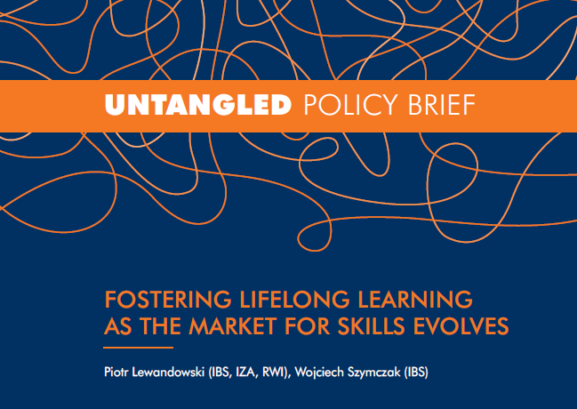
Fostering lifelong learning as the market for skills evolves
Labour market evolution
  New technologies
  Globalisation
  Demographic change
Current policy status quo
  High participation costs
  Extensive workloads
  Family and care responsibilities
  Perceived no need for training
UNTANGLED contribution
  Heterogeneous needs, incentives for training, unequal access to training
  Policy recommendation: individual learning accounts, training leave, on-the-job training
  https://projectuntangled.eu/wp-content/uploads/2023/10/Untangled_policy-brief_2023_IBS.pdf

Slide 18

Philip Schörpf & Myriam Gaitsch
From interested self-endangerment to toxic willingness to perform
Gender perspective on (new) technologies and (techno-)stress at the knowledge-intensive workplace
Project has been funded by the Vienna Science and Technology Fund (WWTF) [10.47379/ICT20034]

Slide 19
Research objectives & research focus
Starting point
Significant changes of work organisation, accelerating of work and
work intensification
  → Communication & collaboration technologies as enabling technology:
    remote work, virtual collaboration, in the sharing of knowledge and ideas
  → Risks: self-exploitation, (techno-)stress (Ragu-Nathan et al. 2008), availability, overload, and ensuing illness
Research focus
Broad: Humanisation of highly digitalised knowledge work
Concrete: What role do gender and affect play in the interplay of new work arrangements (remote work, team work etc.) and communication technologies?

Slide 20
Study design
To study causes of (techno-)stress (and concentration) at work, we adopted a broad perspective and applied a mixed-method-design
  Digital self-tracking tools with smartwatch and headband to collect biometric data
  Smartwatch tracks heartrate (PPG)
  Data processing: heartrate to detect stress frequency
  Interviews with participants at beginning and end of working week
  Supplemented by diary study (daily reconstruction) and
  by short psychological surveys (beginning and end of workday)
Participants receive individualized “experience reports” based on these data
Focus groups aka health circles (Krämer & Berssem, 2010)

Slide 21
Discussion
Digitalized teamwork and vague hierarchies
  Employees increasingly self-structure and manage parts of the labour process
  Also: employees deal with more and more corporate responsibilities (responsible for results) – similarities to Friedman’s (1977) “responsible autonomy”?
  Multiple digital channels to self-organize tasks among team members (in cases of overload or illness, but also for daily business).
Marketization of cooperation and solidarity for organizational purposes
Seems highly gendered
  Women responsible for the emotional tasks necessary to deal with organizational shortcomings (Forseth 2005)
Risk of “toxic work efforts” (overwork, availability, work when sick,…)

Slide 22
Partners
Contact
Twitter@UntangledEU
Facebook.com/UntangledEU
Linkedin.com/company/project-untangled-eu
www.projectuntungled.eu
This project has received funding from the European Union’s Horizon 2020 research and innovation programme under grant agreement No 101004776
This project has received funding from the European Union’s Horizon 2020 research and innovation programme under grant agreement No 101004776

