Slide 1
Cross-country Case Studies of the Impacts of AI Technologies on the Labour Market
18 January 2024
Anna Milanez
Labour Market Economist, Employment, Labour and Social Affairs Directorate
https://www.oecd.org/future-of-work/

Slide 2
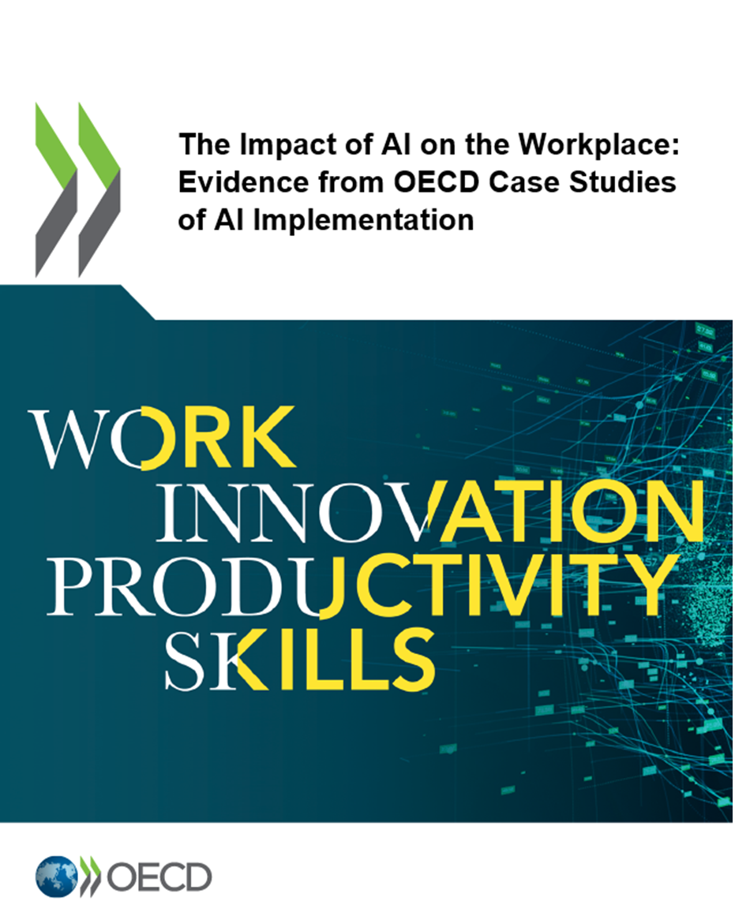
Research design
Firm-level case studies carried out by external researchers
Austria, Canada, France, Germany, Ireland, Japan, the UK and the US
Manufacturing and finance sectors
1-1 semi-structured interviews with stakeholders
Workers, HR managers, management, AI leads,
AI developers, worker representatives
Fieldwork 2021-2022 with publication in
March 2023 (https://doi.org/10.1787/2247ce58-en)

Slide 3
Challenges encountered & final scope
Challenges
Firm recruitment
8-10 firms contacted for each acceptance
Underrepresentation of workers’ perspective
30% with management, 24% AI leads, 17% workers, 9% worker representatives, 11% AI developers, 6% HR managers
Potential positive bias in use cases offered for study
96 firm-level case studies
Informed by 343 interviews (against aim of 384)
Each case study informed by 2-8 stakeholder interviews

Slide 4
Findings highlighted today
Which AI technologies, with impacts on which occupations?
Impacts
Employment levels
Skills
Job quality

Slide 5
Which AI technologies, which occupations?
Most prevalent AI technologies
Occupations most often impacted
Finance | Manufacturing
Natural language processing To retrieve data and information from customers To route customer emails | Computer vision To quality assure components along a production line To monitor production processes
Computer vision | Natural language processing
Machine learning
Finance | Manufacturing
Customer service representatives (14) | Maintenance & repair workers (11)
Fraud examiners, investigators, analysts (5) | Electromechanical equipment assemblers (9)
Insurance claims & processing clerks (4) | Aircraft mechanics & service technicians (3)

Slide 6
Job loss has been limited – at least so far
Redundancies were rare
AI technologies were not advanced enough
AI technologies tended to automate minor share of tasks within jobs
Given labour shortages, workers were often reallocated within firms
Firms were motivated by improved product or service quality rather than labour cost savings
However, many mentions of slowed hiring
No examples of “new” occupations
“There is so much to gain in terms of efficiency, but there will always be headcount. […] The idea is to move people off tasks that can be automated, especially non-value-added tasks.”
─ Aerospace manufacturer, US

Slide 7
Skill needs and training
In the case studies, skill needs often remained the same
Small task changes
Jobs reorganised among pre-existing tasks
Marginally new ICT skills
Changes
New skills (but rarely specialised AI skills)
Greater reliance on existing human skills
Skill redundancies in manufacturing
“The skillset required to run [the AI] is not sophisticated. By designing a system that can be run very intuitively, we don't need to increase the skillset of people running it. Anybody can run it.”
─ Manager in auto manufacturing, Canada

Slide 8
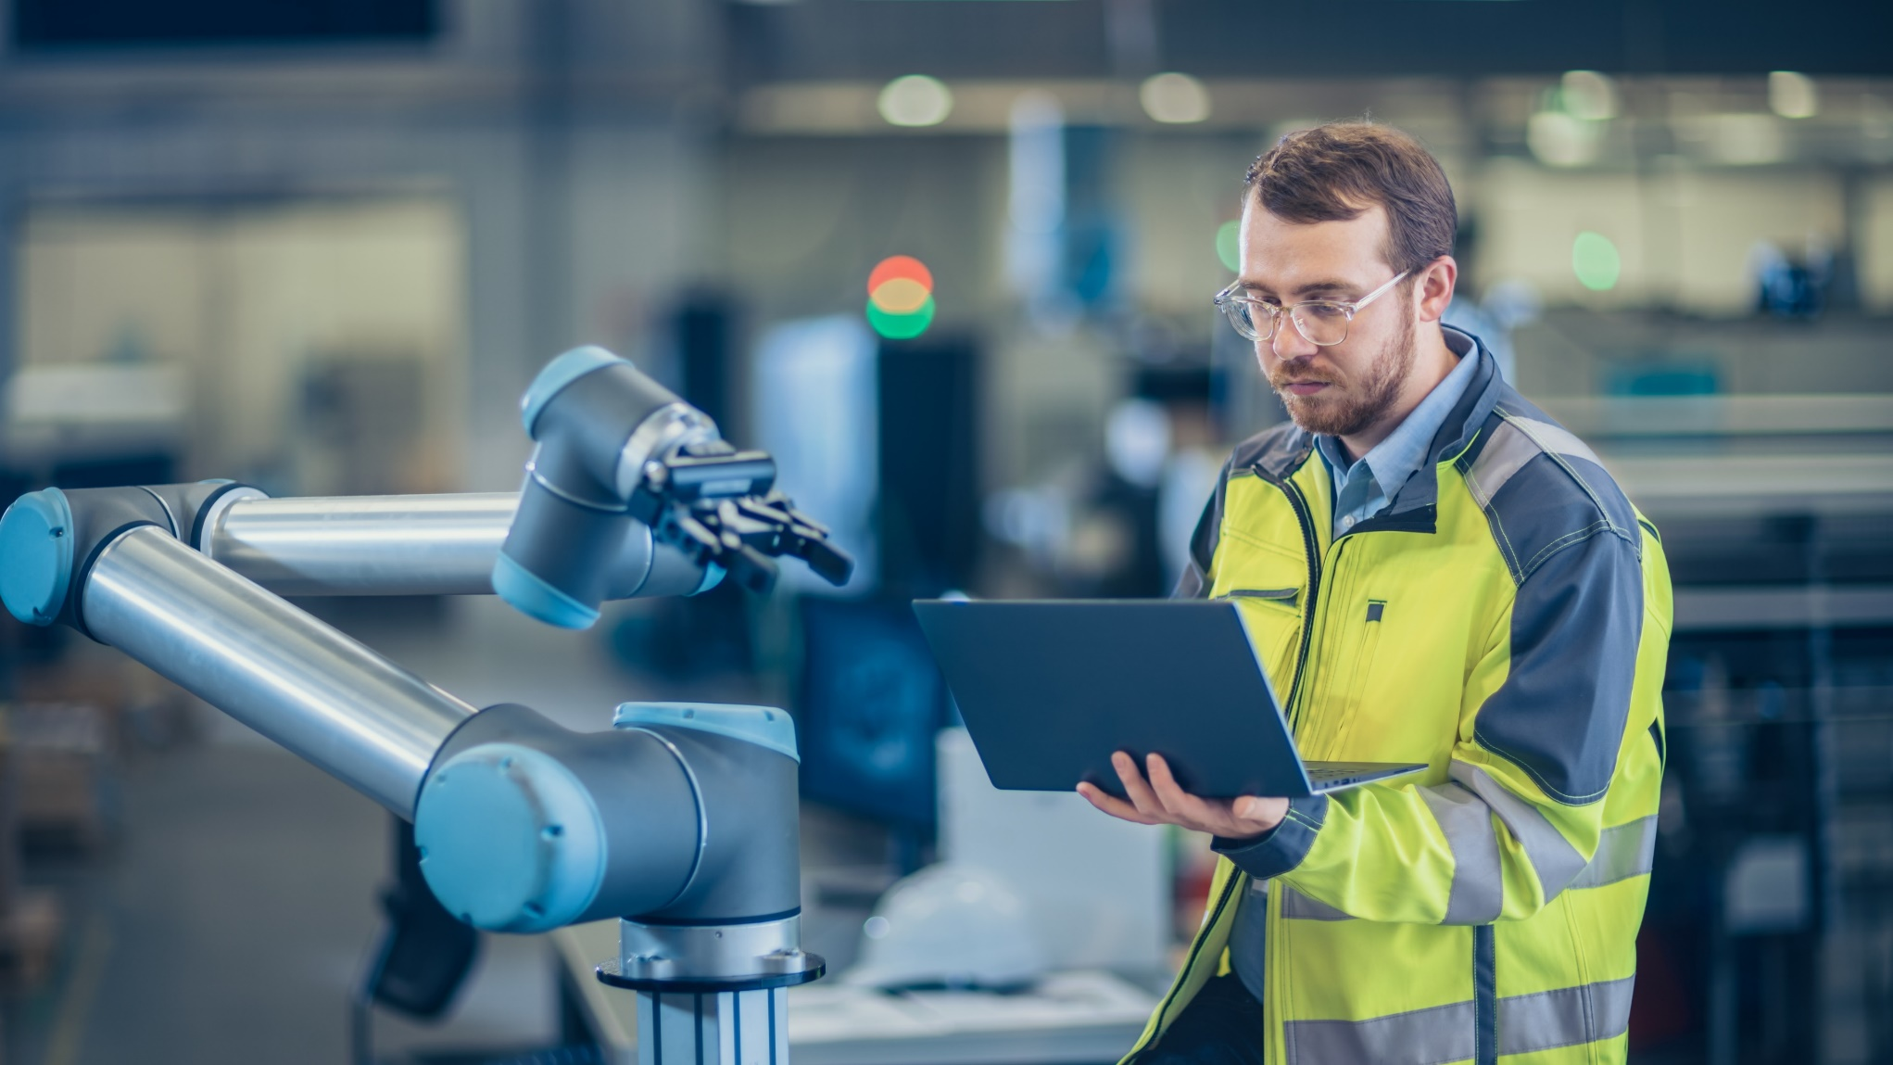
Mixed impacts on jobs quality
In the case studies, non-worker interviewees credited AI technologies with improved
Physical safety
Working conditions
Mental well-being
Engagement
Conflicting perspectives
Developer perceptions of AI technologies were most positive, with workers often more ambivalent
There were also reports of increased work intensity and stress
“The pace of work is certainly increasing. Particularly in [white collar jobs], things are moving much faster, and the range of work is increasing. There is a risk that people will be massively overtaxed.”
─ Works council member, Austria

Slide 9
Thank you!
Contact: Anna.Milanez@oecd.org
Report: https://doi.org/10.1787/2247ce58-en
Additional work: https://www.oecd.org/future-of-work/reports-and-data/

